Slide 1
Mastering Blockchain Third Edition
Chapter 19, Blockchain – Outside of Currencies

Slide 2
Outline
The Internet of Things (IoT)
Government
Health
Finance
Media

Slide 3
A typical IoT network
A typical IoT network consists of many devices; cars, cameras, houses, fridges, and more, which can gather data and communicate it over the internet

Slide 4
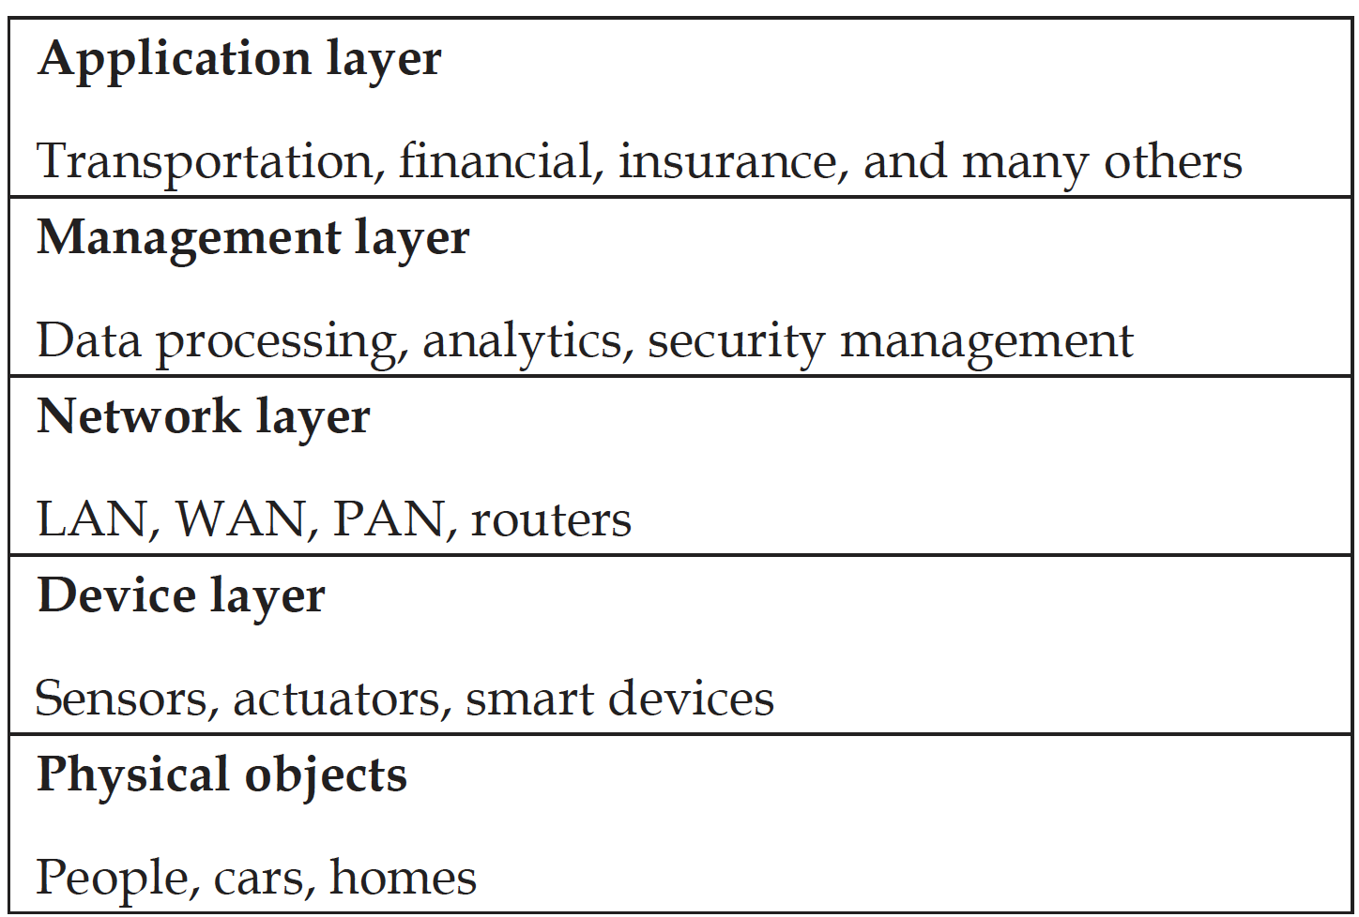
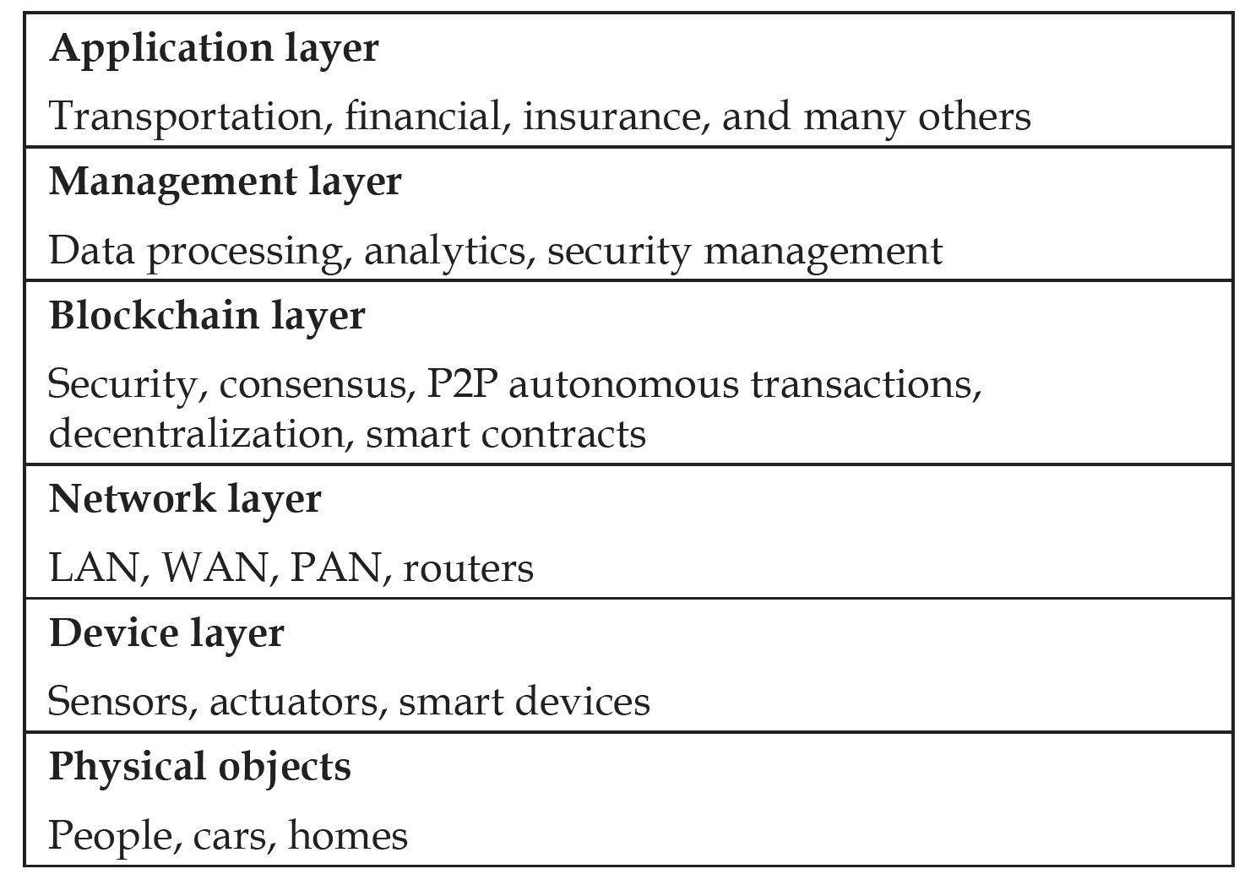
IoT layered architecture, with and without blockchain
The five-layer IoT model (the model on the left) can be adapted to a blockchain-based model (on the right) by adding a blockchain layer on top of the network layer. This layer will run smart contracts and provide security, privacy, integrity, autonomy, scalability, and decentralization services to the IoT ecosystem.
Without blockchain
With blockchain

Slide 5
Blockchain-based IoT
Below is a blockchain-based IoT model, where blockchain serves as a communication, consensus and secure peer to peer (P2P) layer between devices on the network.

Slide 6
An IoT device operating with and without a local ledger
An IoT device with a local ledger runs a ledger on the IoT device itself.
However, IoT devices can run without a local ledger, where they connect to a another Geth node via RPC, usually over HTTP.
Both of these approaches are demonstrated in the following diagrams
IoT device without local ledger
IoT device with local ledger

Slide 7
Use cases of blockchains in government
Government
Border control
Voting
Citizen ID cards
Border control
A key potential application of blockchain in government is border control. If this process was based on a blockchain, it might consist of the following elements:
A smart contract handling the verification logic
A frontend that the visa officer might use
A scanner to scan the passport, either by visual image capture or reading the RFID chip containing the traveler data
A backend, preferably a decentralized encrypted storage. However, in traditional settings, it could also be a central database owned by the border control department

Slide 8
Use cases of blockchains in finance
There are also many use cases of blockchain technology in finance:
Insurance
Automatic and secure evaluation of insurance claims
Automatic payouts
Post-trade settlement
Real-time post-trade settlement without manual reconciliation
Financial crime prevention
Due to transparency and data integrity provided by blockchain technology, financial crimes such as frontrunning can be detected and thwarted
Payments
Cross-border payments made quicker and secure using blockchain

Slide 9
Use cases of blockchain in other industries
Health industry
Secure health data sharing among health providers
Patient has full control over their identity and data, and can share information on need-to-know basis
Media industry
Digital rights management: simply copying a music file and sharing it over the internet impossible
Easier and quicker royalty payments, in a scenario where artists connect directly to consumers, without any agent or extra fees
Music/art sold without any fear of copyright violation and royalty paid directly to the artist

Slide 10
Exercise
Consider which modern industry would be most improved by the implementation of blockchain technology.
Why?
How could this become a reality?

Slide 11
Summary
In this presentation, we discussed:
Some applications of blockchain
The IoT, and how it could be transformed into a blockchain-based model
Applications in the government sector were discussed, where homeland security, identification cards, and benefit disbursements can be made transparent, secure, and more robust.
The finance sector was discussed, with possible solutions that blockchain technology could provide
Health and media use cases were also considered

